Slide 1
Module 1 Overview of Design and Build a Data Warehouse
Lesson 3: Executive Interview with Tyler Wilson of CPI Card Group
Notes:
Welcome to Lesson 1 of Module 1 on Design and Build a Data Warehouse for Business Intelligence Implementation
Four course sequence on data warehouse and business intelligence essentials along with a capstone project course
Fifth course providing a case study based on the business situation faced by CPI Card Group
Fun but challenging course for both business and computer science students
Learn new concepts, skills, and practices vital to careers in data warehousing and business intelligence

Slide 2



Slide 3

Selected Facts
Largest USA provider of plastic credit and debit cards
Industry leaders in the financial and prepaid markets
More than 4,000 customers
$338M revenue 2015 fiscal year
1300+ employees

Slide 4
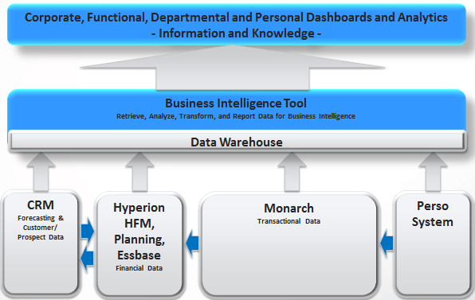
Analytics Strategy

Slide 5
Driving Factors
Lack of a consolidated view
Insights into real-time data
Improve productivity for report generation

Slide 6

2016 CPI Business Intelligence Roadmap
Financial Foundation: Sales Gross Margin, BBB, Direct Labor, Efficiency, Chargeability
Operational Quality: Define by business unit, kickoff Q1 2016, super user training
Sales, Product, Segment Analysis: Align transactional systems, top down definition, near real time metrics
Executive & Management Decision Support: Single picture of current & past positions, exception reporting, holistic business unit view
Corporate Data Excellence: Formal data governance and management, single source of truth, business alignment

